Slide 1
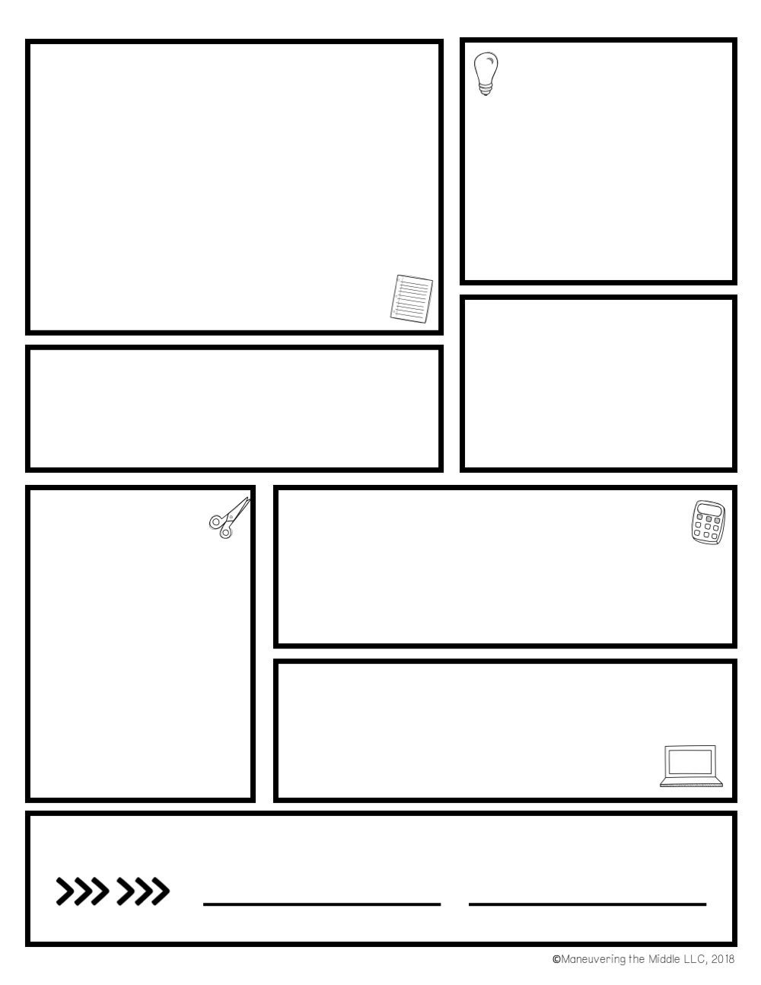
Language Arts with
Mrs. Borek
We will be doing a lot of reading and writing this year!
We will use our reading strategies as we read novels together as a class, in literature circles, with partners, and independently.
We will write a lot this year, whether it is reading responses, essays, or narratives. We will improve our word choice, sentence structure, and challenge ourselves to add specific details and explain and support our ideas.
Supplies Needed:
Student Handbook
A folder with pockets
3 ring binder with tabs and TONS of paper ☺
Pencils
A blue or black pen
Sticky notes
A highlighter
Contact:
jborek@bordentown.k12.nj.us
609-298-0674
www.tinyurl.com/jborek
Twitter: @Mrs_Borek
Grades
A: 100-90
B: 89-80
C: 79-70
D: 69-65
F: 64-0
Grading
Come to class on time
Leave big backpacks in your locker
Bring all LA supplies/books (you will NOT be allowed back to your locker)
Give your best effort and challenge yourself
Participate, be creative, and be enthusiastic
Be respectful of everyone and everything at all times
I EXPECT YOU TO-
Grades will be based on your progress and effort. Daily observations and rubrics will be used to assess your work.
Tests and Quizzes: 30%
Writing assignments and Projects: 30%
Homework: 20%
Class Work/Participation: 20%
Don’t forget to ask for help if you are struggling!
YOU CAN EXPECT TO-
Work hard, but have fun
Have meaningful homework regularly
Know about all assignments in advance
Receive fair and respectful treatment
Have an enthusiastic teacher that
cares about your learning
Student Signature:

Slide 2
Homework:
Graded for following directions, effort, and completion. Points will be lost if assignment is incomplete or lacks effort.
Will be posted on the board and on my website every night
Late homework will earn half credit (up to one day late)
Plagiarized work will not be accepted (this includes copying work from a friend)
Questions about homework: Email me before 8:00 pm or call a friend
Other Grading Policies:
Effort matters!
Long term projects or assignments will lose 5 points for each day it is late.
Final copies MUST follow guidelines to receive full credit.
ANY plagiarized work will receive a zero and you will not have an opportunity to make up the assignment.
Work turned in without a name will lose 2 points.
Absences:
It is YOUR responsibility to check the “What Did I Miss?” board at the beginning of class or in homeroom.
The day you return: hand in ALL work that was due. I will not ask you for it.
Get clarification from a buddy or from me if you are confused.
Make up quizzes/tests ASAP
PowerSchool
Please check it regularly!
Most grades are entered by the end of the week.
Major writing assignments and projects will take more time to grade ☺
I’m definitely not perfect. Ask questions if you suspect an error.

Slide 3
Please return ONLY this page and keep the other for your reference:
I have read and I understand all of Mrs. Borek’s expectations:
Student Name (print)___________________________________
Parent name (print): ___________________________________
Parent signature: _____________________________________
Parent Contact Information:
E-mail: ___________________________________________
2nd E-mail (optional): __________________________________
Phone number: ______________________________________
Helpful class updates will be e-mailed home weekly. If you don’t receive an update by the end of the first full week of school, please e-mail me so you don’t miss any important information.
Should I be aware of any other significant information about your student that will enable me to better assist him/her this year in LA?
________________________________________________
________________________________________________ ________________________________________________ ________________________________________________ ________________________________________________ ________________________________________________

